Slide 1
Design and drawing for production

Slide 2
Unit 2 – The title block
Section 2 – Architect Scale

Slide 3
The big idea
Understand the importance of architect scale usage
Be sure to always identify the scale used
Adding the used scale to our Title Blocks
Using various scales

Slide 4
Google classroom code
okia9n

Slide 5
Section 1 review
Title Block Mastery
Drawing #1
Title Block Test
Drawing #2

Slide 6
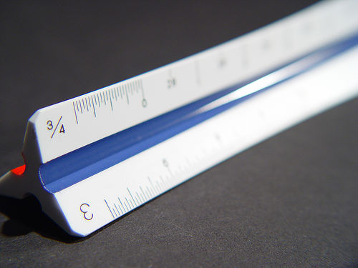
Architect Scale
A triangular shaped instrument used for making or measuring scaled drawings such as blueprints or floor plans.

Slide 7
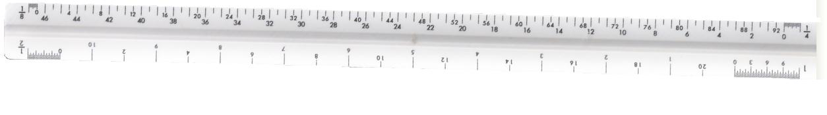
Architect Scale
The scale can be read from left to right and right to left.
1/8” scale would be read from left to right and the ¼” scale would be read from right to left.

Slide 8
Architect Scale

Slide 9
Drawn to scale?
On a scaled drawing, a small measurement is used to represent a large measurement.
For example, one-fourth inch (¼”) on the plan may represent one foot (1’) in the real world.

Slide 10
Drawn to scale?
Floor plans for residential structures are usually drawn at ¼” = 1’.
Commercial buildings may be drawn at 1/8” = 1’ if they are too large to fit on the desired sheet size at ¼” = 1’.

Slide 11
Assignment PLanning
DUE TODAY!!!!
Architect Scale handout
DUE MONDAY
Architect scale handout manual copy
SCHEDULED FOR TUESDAY
Architect Scale Test
NEXT UNIT
Lettering
***BE SURE TO COMPLETE VIA GOOGLE CLASSROOM***

